Slide 1

AI Conversation Analytics – Technical Deep Dive
A modular pipeline for extracting actionable insights from conversational AI data, designed for data scientists and ML engineers building scalable analytics solutions.

Slide 2







Pipeline Overview
Load & Filter
Preprocess
English, non-toxic subset
Clean & normalize text
Topic Modeling
Sentiment Analysis
BERTopic (UMAP + HDBSCAN)
Rule-based + LLM extraction
Synthesis
Entity Clustering
Visualizations
Merge to unified table
Group similar entities
Actionable insights
This pipeline provides a systematic approach to extract structured insights from unstructured conversation data, with built-in fallbacks at every stage to ensure robustness.

Slide 3


Problem & Objectives
Our pipeline addresses the challenge of extracting actionable insights from conversational AI data at scale. Key objectives include:
Analyze Real-World AI Conversations
Ensure Reproducibility
Provide deterministic, reproducible visuals and queries for consistent analytics workflows
Extract actionable insights from messy, real-world conversational data for brands and product teams
Build Modular Pipeline
Create a robust, high-performance pipeline with independently executable components

Slide 4
Data Sources & Pipeline Order
Data Sources
Order of Operations (Why)
Source: WildChat subset (English, non-toxic)
Preprocess before topics to improve topic quality and reduce noise
Outputs: Nested LLM JSONL, flat entity-level CSV/JSONL
Analysis table: data/04_analysis/unified_table.csv
Topics before synthesis to provide context fields for later analysis
We focus on English, non-toxic content for US brands to reduce noise, with configurable sample size to balance coverage and computational resources.
Rule-based sentiment before LLM synthesis for complete sentiment features
LLM extraction before visualization to enable per-entity analytics
Synthesis validates and aligns all fields for visualization
This order maximizes efficiency and quality while ensuring each component has the necessary inputs from previous stages.

Slide 5

Tools & Libraries
Core Technologies
NLP & ML Components
Python 3.13
VADER, TextBlob for rule-based sentiment
pandas for data manipulation
matplotlib, seaborn for visualization
BERTopic for topic modeling
UMAP for dimensionality reduction
numpy for numerical operations
HDBSCAN/KMeans for clustering
Advanced Features
sentence-transformers for embeddings
OpenAI LLM for extraction (intent/entities/sentiment)
asyncio for concurrent processing
scikit-learn for fallback algorithms

Slide 6
Load & Preprocess
Load & Filter
Preprocess
# src/hf_loader.py (lines: 27-44)
ds = load_dataset("allenai/WildChat", split=split, token=token)
df = pd.DataFrame(ds)
mask = (df["language"] == language) & (df["toxic"] == False)
filtered = df.loc[mask]
if limit is not None:
filtered = filtered.head(limit)
# src/text_cleaning.py (lines: 12-20)
s = _URL_RE.sub(" ", s)
s = _KEEP_CHARS_RE.sub(" ", s)
s = _WHITESPACE_RE.sub(" ", s).strip()
s = s.lower()
What we do: Remove URLs, collapse whitespace, keep common punctuation, lowercase, and normalize each conversation turn consistently.
Filters focus on English, non-toxic content with configurable sample size to balance coverage and computational resources.
Why: Improves vectorization and topic stability while reducing noise from junk tokens.

Slide 7
Topics (BERTopic) & Sentiment Analysis
BERTopic Implementation
Rule-based Sentiment
We implement a robust topic modeling pipeline with built-in fallbacks:
We leverage two complementary sentiment analysis approaches:
Remove stopwords to capture meaningful content words
# src/sentiment_rule_based.py (lines: 33-45)
analyzer = SentimentIntensityAnalyzer()
scores = analyzer.polarity_scores(text)
tb = TextBlob(text)
polarity, subjectivity = tb.sentiment
Use UMAP to reduce dimensionality while preserving structure
Cluster with HDBSCAN (density-based)
Include vectorizer fallbacks for sparse corpora
Keep Topic -1 (Other) to preserve uncategorizable documents
# Vectorizer fallback
try:
topics_eff, probs_eff = topic_model.fit_transform(eff_docs)
except ValueError:
topic_model = build_model(min_df=1, max_df=1.0, ngram=(1, 1))
topics_eff, probs_eff = topic_model.fit_transform(eff_docs)
Why dual methods: VADER and TextBlob provide methodological redundancy, increasing confidence when they agree and highlighting ambiguity when they diverge.
What we compute: VADER produces positive/negative/neutral/compound scores, while TextBlob provides polarity and subjectivity metrics.

Slide 8

LLM Extraction & Concurrency
Goals & Implementation
Our LLM extraction pipeline extracts conversation intent, entities, and per-entity sentiment with high throughput:
Extraction Targets
Overall conversation intent & sentiment
Nested entities with category classification
Per-entity sentiment (may diverge from conversation sentiment)
Performance Optimization
Semaphore-bounded async calls (limit parallel requests)
Exponential retry/backoff for API resilience
Progress logging for visibility into long-running jobs
# src/llm_analysis.py (lines: 198-233)
sem = asyncio.Semaphore(concurrency)
async def bound_analyze(r): async with sem: # Controls max concurrent requests return await _analyze_single_async(client, r, model)

Slide 9
Synthesis & Entity Clustering
Synthesis to Unified Table
Entity Clustering
We merge multiple data streams into a unified analysis table:
We cluster entities using a robust, multi-fallback approach:
Load cleaned conversation text and derive full_text
# Entity clustering fallback pipelinetry: # Primary:
HDBSCAN (auto-discovers clusters)
clusterer = hdbscan.HDBSCAN( min_cluster_size=min_cluster_size, metric="euclidean" )
labels = clusterer.fit_predict(embeddings).astype(int)
except:
try: # Fallback 1: KMeans (fixed clusters)
km = KMeans(n_clusters=k, n_init=10, random_state=42)
labels = km.fit_predict(embeddings).astype(int)
except: # Fallback 2: Simple bucketing
labels = np.arange(n, dtype=int) // bucket
Merge doc_topics with human-readable topic names
Merge rule-based sentiment by conversation_id
Merge LLM flat outputs (duplicating rows for per-entity analytics)
Write unified CSV/XLSX for analysis
# src/synthesis.py (lines: 94-104)
base = cleaned_df.merge( doc_topics[["conversation_id","topic_id","topic_name"]], on="conversation_id", how="left")
if not rule_df.empty:
base = base.merge(rule_df, on="conversation_id", how="left")
if not llm_df.empty:
base = base.merge(llm_df, on="conversation_id", how="left")

Slide 10


Visualizations & Performance Optimizations
Visualization Types
Performance Optimizations
Mentions distributions: Entity frequency across conversations
Entity-weighted averages: Sentiment by entity importance
LLM Processing
Co-mention heatmaps: Entity relationships with sentiment coloring
Async with bounded concurrency and retry/backoff logic to maximize throughput while respecting API limits
Conversation sentiment by intent: Emotional patterns by conversation purpose
--max_llm_rows for iteration; --skip_llm to reuse
These visualizations help prioritize product improvements and support resources based on conversation volume and sentiment patterns.
Data Operations
Vectorized operations (crosstab/groupby) with minimal joins to reduce memory usage and processing time
Robust Fallbacks
HDBSCAN → KMeans → buckets cascading fallbacks ensure the pipeline never fails even with weak data structure
Run the complete pipeline with: python -m src.run_pipeline --limit 1000 --llm_model gpt-4.1-nano --max_llm_rows all --concurrency 1

Slide 11
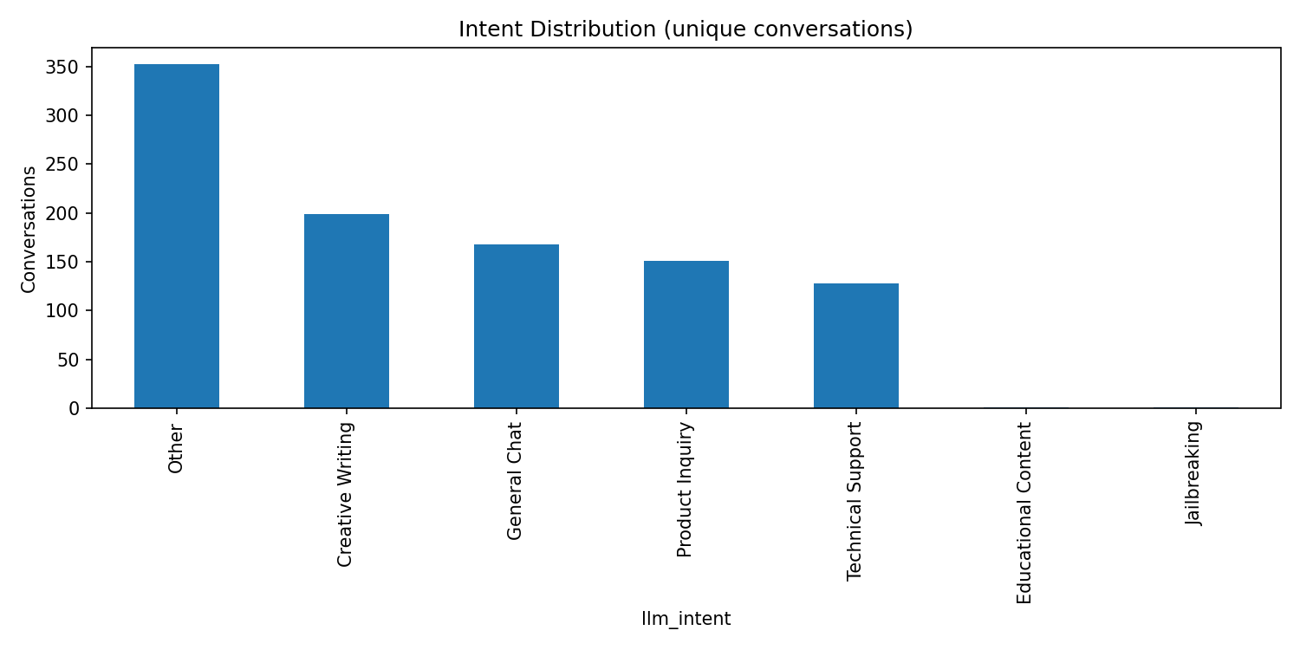
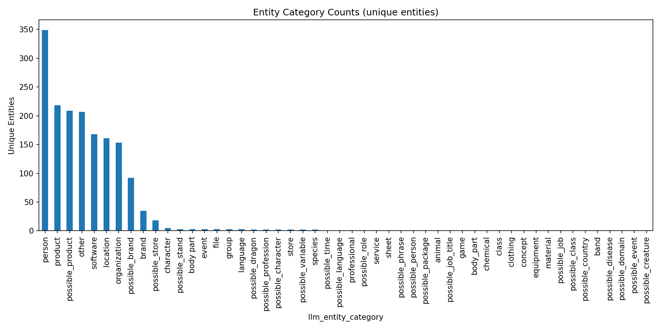
Intent and Entity Distribution Analysis
Intent Distribution
Entity Category Counts
This visualization breaks down conversation chains by category, revealing which topics dominate customer discussions. Understanding intent distribution helps prioritize product development and support resources based on customer conversation patterns.
Reveals categories with the highest number of unique entities mentioned, essential for scoping brand/product analytics. For example, in the Software category, mentions of "Nike," "nike," and "adidas" would count as 2 unique entities.
Key insight: Focus resources on categories with high entity diversity to capture competitive intelligence.
Key insight: Identify which conversation categories require immediate attention based on volume and strategic importance.

Slide 12
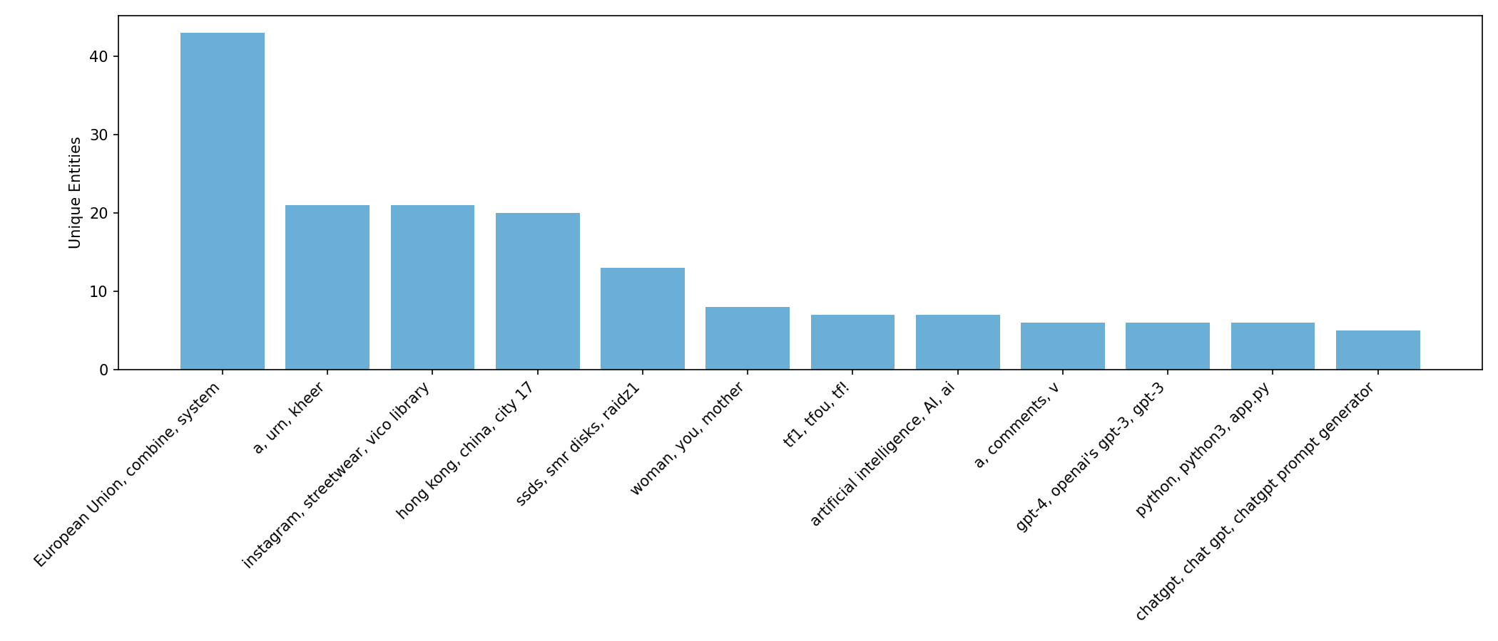
Entity Clustering Analysis
Cluster Formation
Labeled Visualization
Strategic Application
Entities are grouped based on similarity metrics, creating meaningful thematic clusters that reveal related brands, products, or concepts.
The top clusters by number of unique entities are displayed with labels showing normalized names per cluster, making it easy to identify major themes and competitor groups.
Use clusters to track competitive landscapes, identify emerging market segments, and understand how customers conceptually group products or services.
Entity clusters reveal hidden relationships between brands, products, and concepts that might not be obvious from raw data alone. These patterns can inform competitive intelligence and market positioning strategies.

Slide 13
Sentiment Analysis Methodologies
Three Distinct Approaches
LLM Sentiment
VADER Sentiment
TextBlob Sentiment
Uses advanced language models to analyze contextual sentiment, capturing nuanced emotional responses and implied attitudes.
Valence Aware Dictionary and sEntiment Reasoner - specifically attuned to social media sentiment with rules for emphasis, punctuation, and modifiers.
Implements a traditional lexicon-based approach that assigns polarity scores to words and phrases based on pre-defined dictionaries.
Each sentiment analysis method brings unique strengths to conversational analytics. LLM excels at context-sensitive interpretation, VADER captures social media nuances, and TextBlob provides consistent lexical analysis. Using multiple methods allows analysts to triangulate true sentiment with higher confidence.

Slide 14
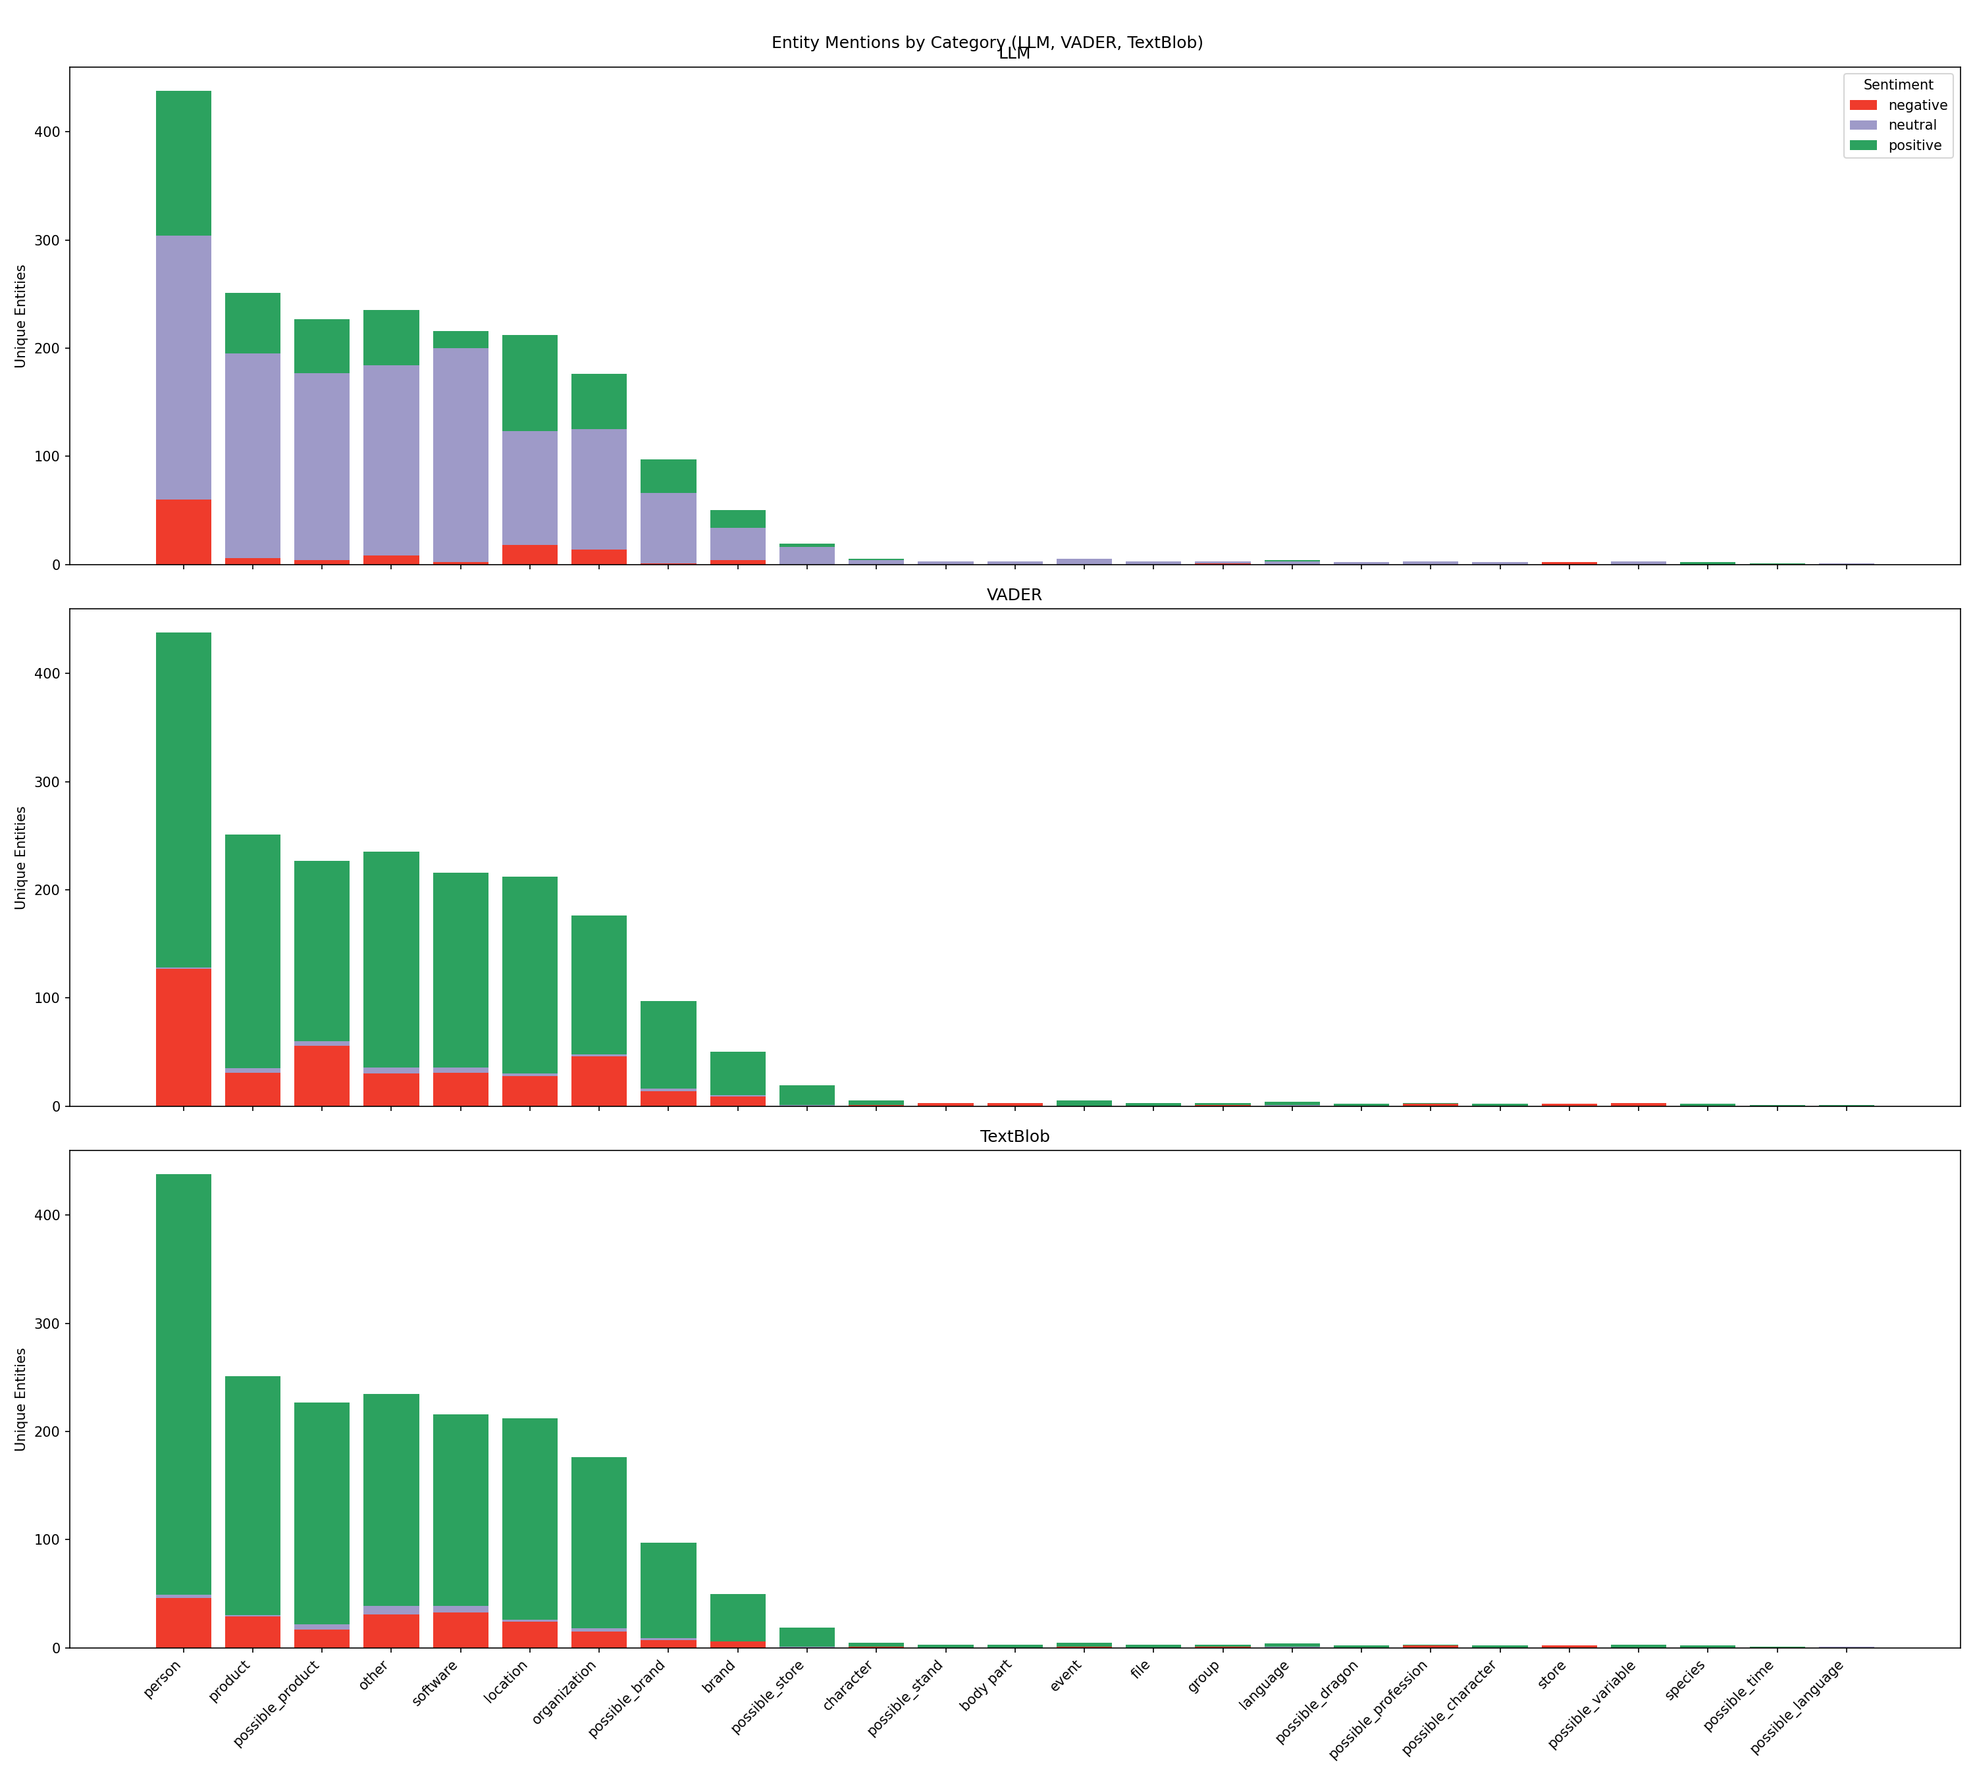
Entity Sentiment by
Category
Frequency-Based Analysis
For each entity category (Brand, Organization, Product, etc.), frequency charts display the distribution of sentiment across three buckets:
Negative: Expressions of dissatisfaction, criticism, or problems
Neutral: Factual references without emotional content
Positive: Expressions of satisfaction, praise, or preference
Important: Mixed sentiment is not averaged. An entity with both positive and negative mentions contributes to both buckets according to mention frequency, preserving the full complexity of sentiment data.
Visualization allows quick identification of categories with disproportionate sentiment patterns requiring deeper investigation.

Slide 15

Combined Sentiment Analysis Comparison
Side-by-side frequency panels (LLM/VADER/TextBlob) reveal how different sentiment analysis methods interpret the same conversational data, providing analytical triangulation.
3
0
100%
Analytical Methods
Averaged Neutrality
Data Preservation
Different algorithms analyze sentiment through unique lenses, each with distinct strengths in capturing emotional context.
When sentiment scores are mapped to -1/0/+1 and averaged, categories with divergent opinions may appear deceptively neutral.
Combined views maintain the full spectrum of sentiment expression without collapsing mixed opinions into averaged values.

Slide 16
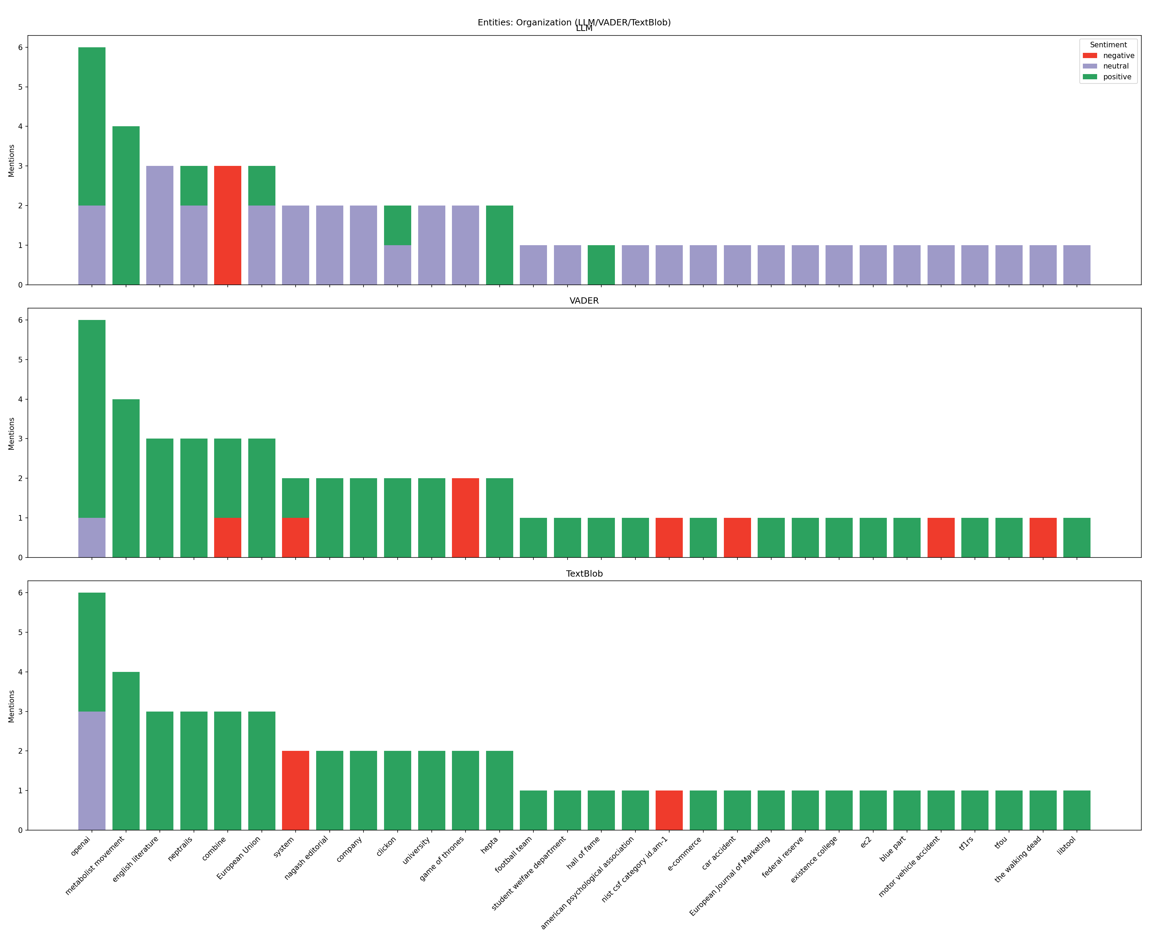
Multi-Sentiment Entity Analysis (Organizations)
Granular Entity-Level Insights
Multi-panel frequency charts for specific categories (Brand, Organization, Possible Brand/Store/Product) reveal sentiment patterns for individual entities:
Each entity's stacked bar shows sentiment distribution across three methods
Particularly valuable for tracking ambiguous mentions likely to be brands/stores/products
Essential for discovery of emerging entities not yet formally categorized
Strategic application: Compare sentiment profiles between direct competitors to identify competitive advantages and vulnerabilities in customer perception.

Slide 17
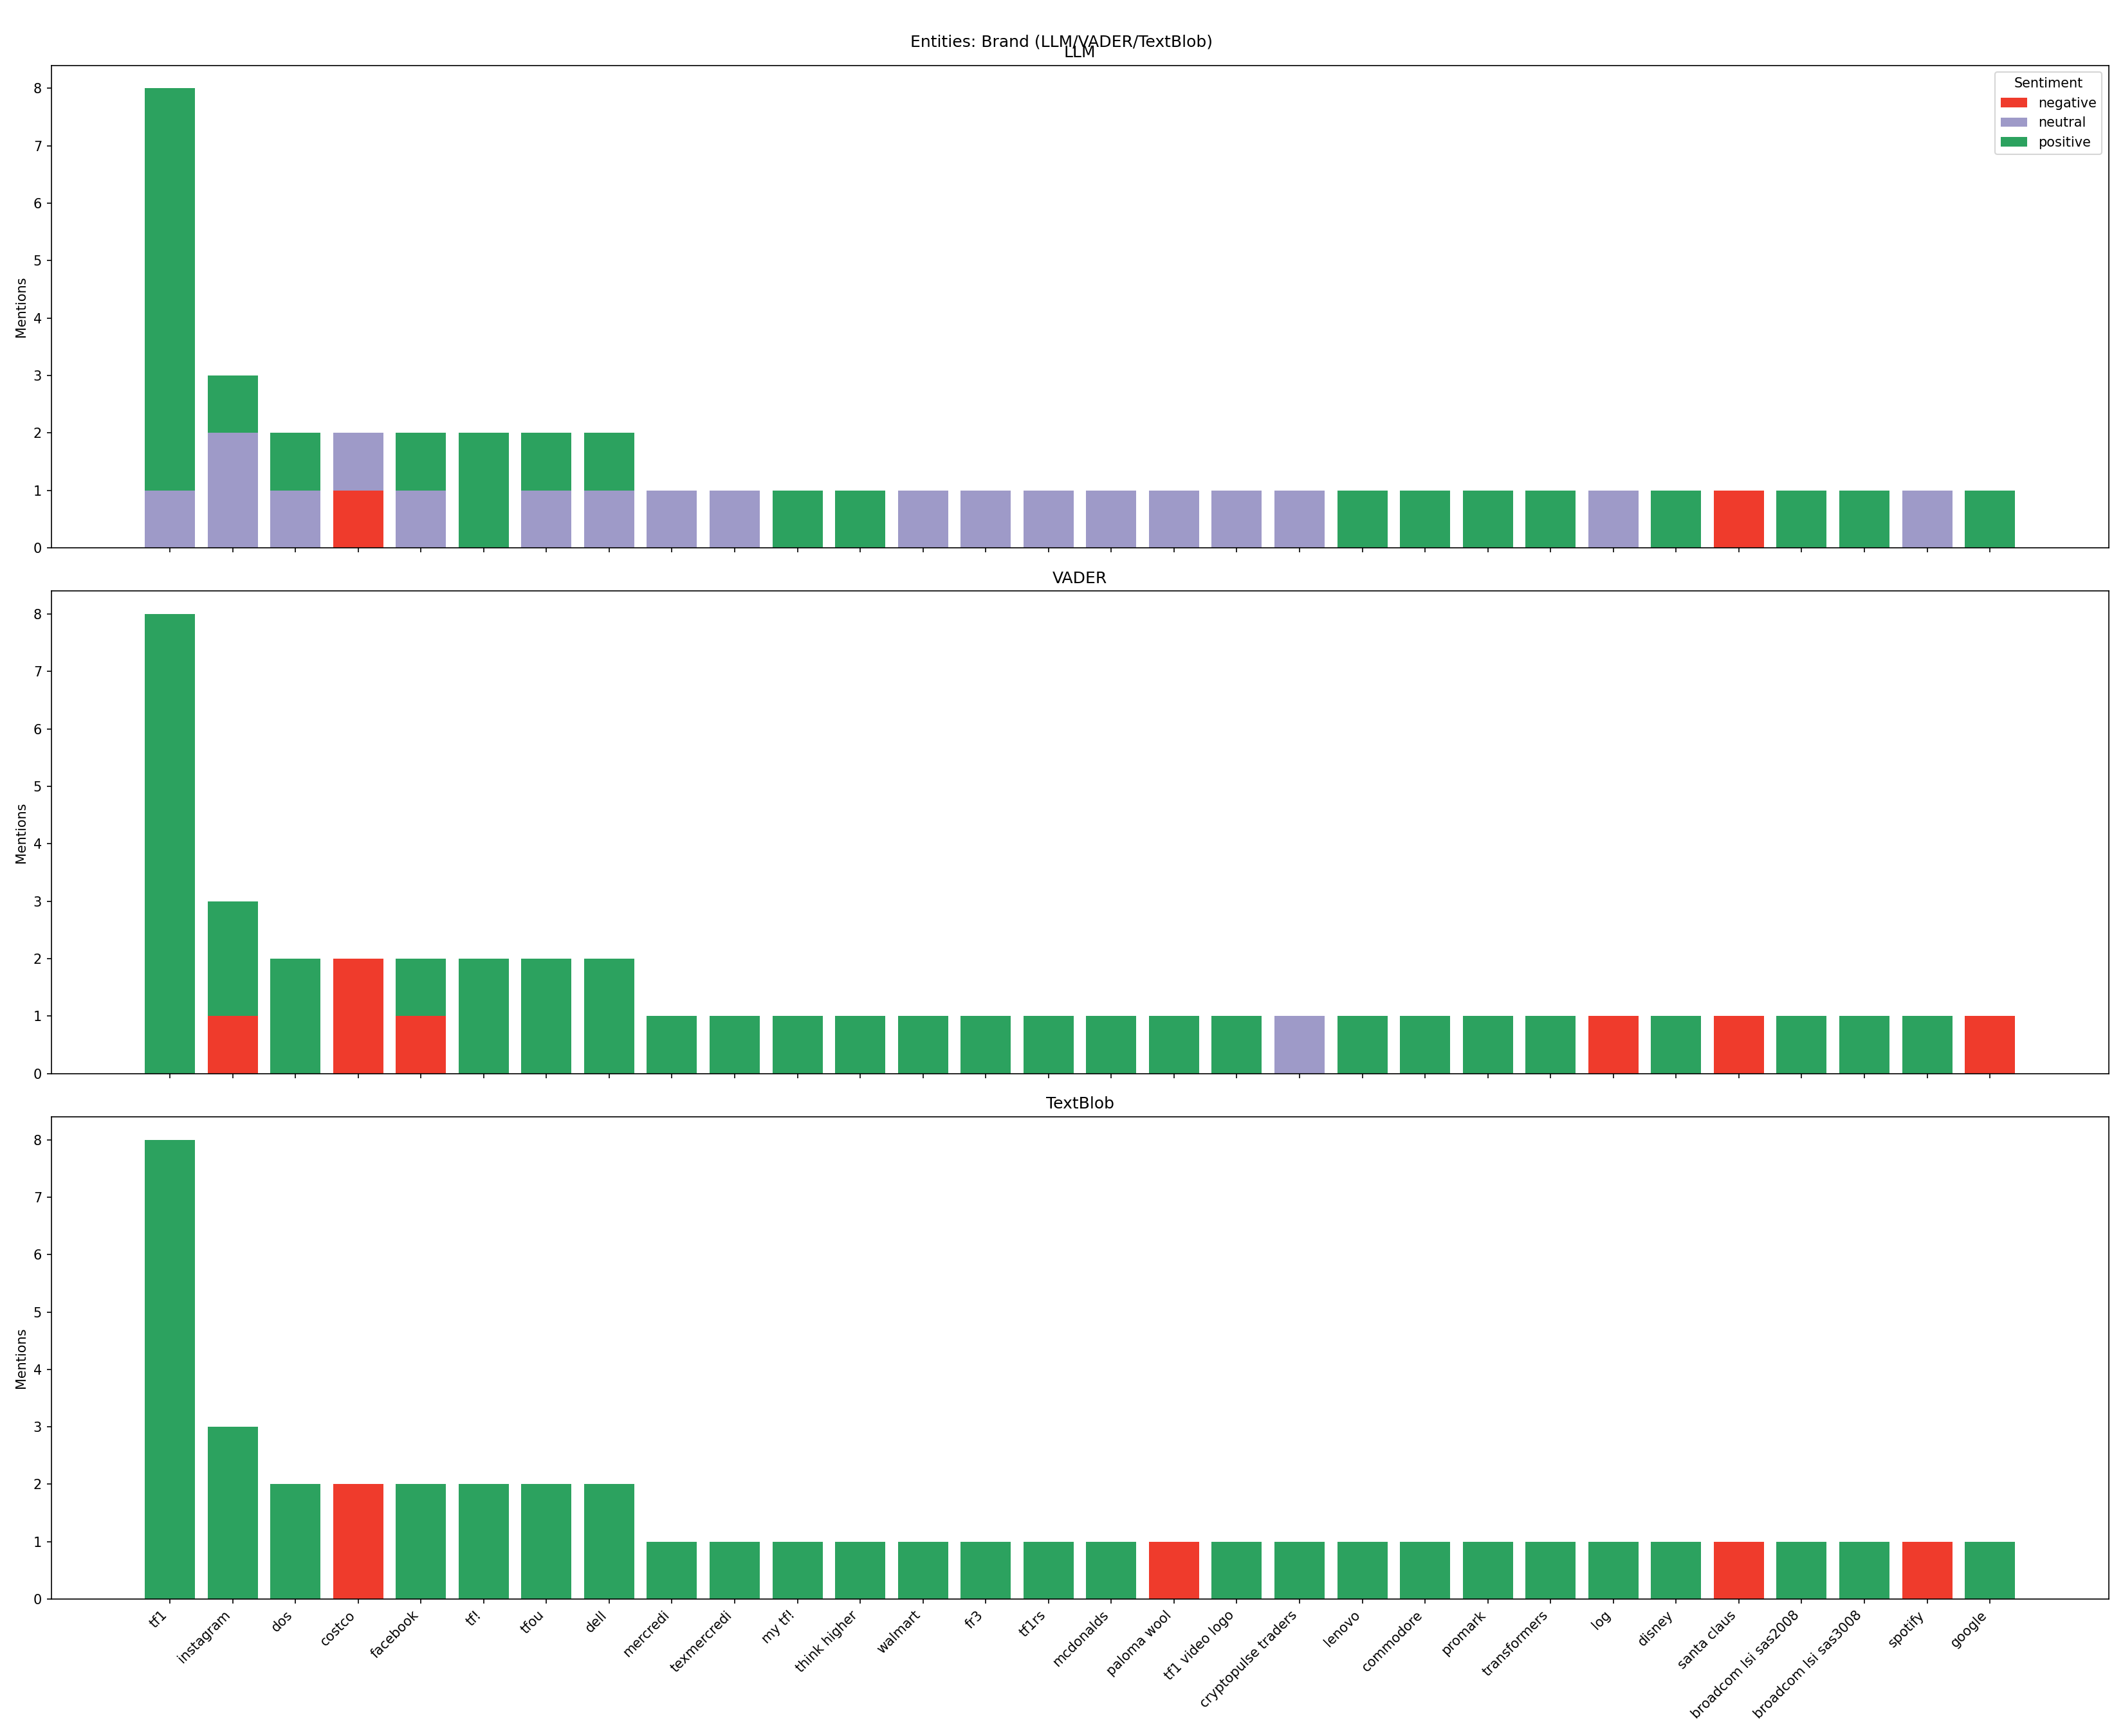
Multi-Sentiment Entity Analysis (Brands)
Granular Entity-Level Insights
Multi-panel frequency charts for specific categories (Brand, Organization, Possible Brand/Store/Product) reveal sentiment patterns for individual entities:
Each entity's stacked bar shows sentiment distribution across three methods
Particularly valuable for tracking ambiguous mentions likely to be brands/stores/products
Essential for discovery of emerging entities not yet formally categorized
Strategic application: Compare sentiment profiles between direct competitors to identify competitive advantages and vulnerabilities in customer perception.

Slide 18
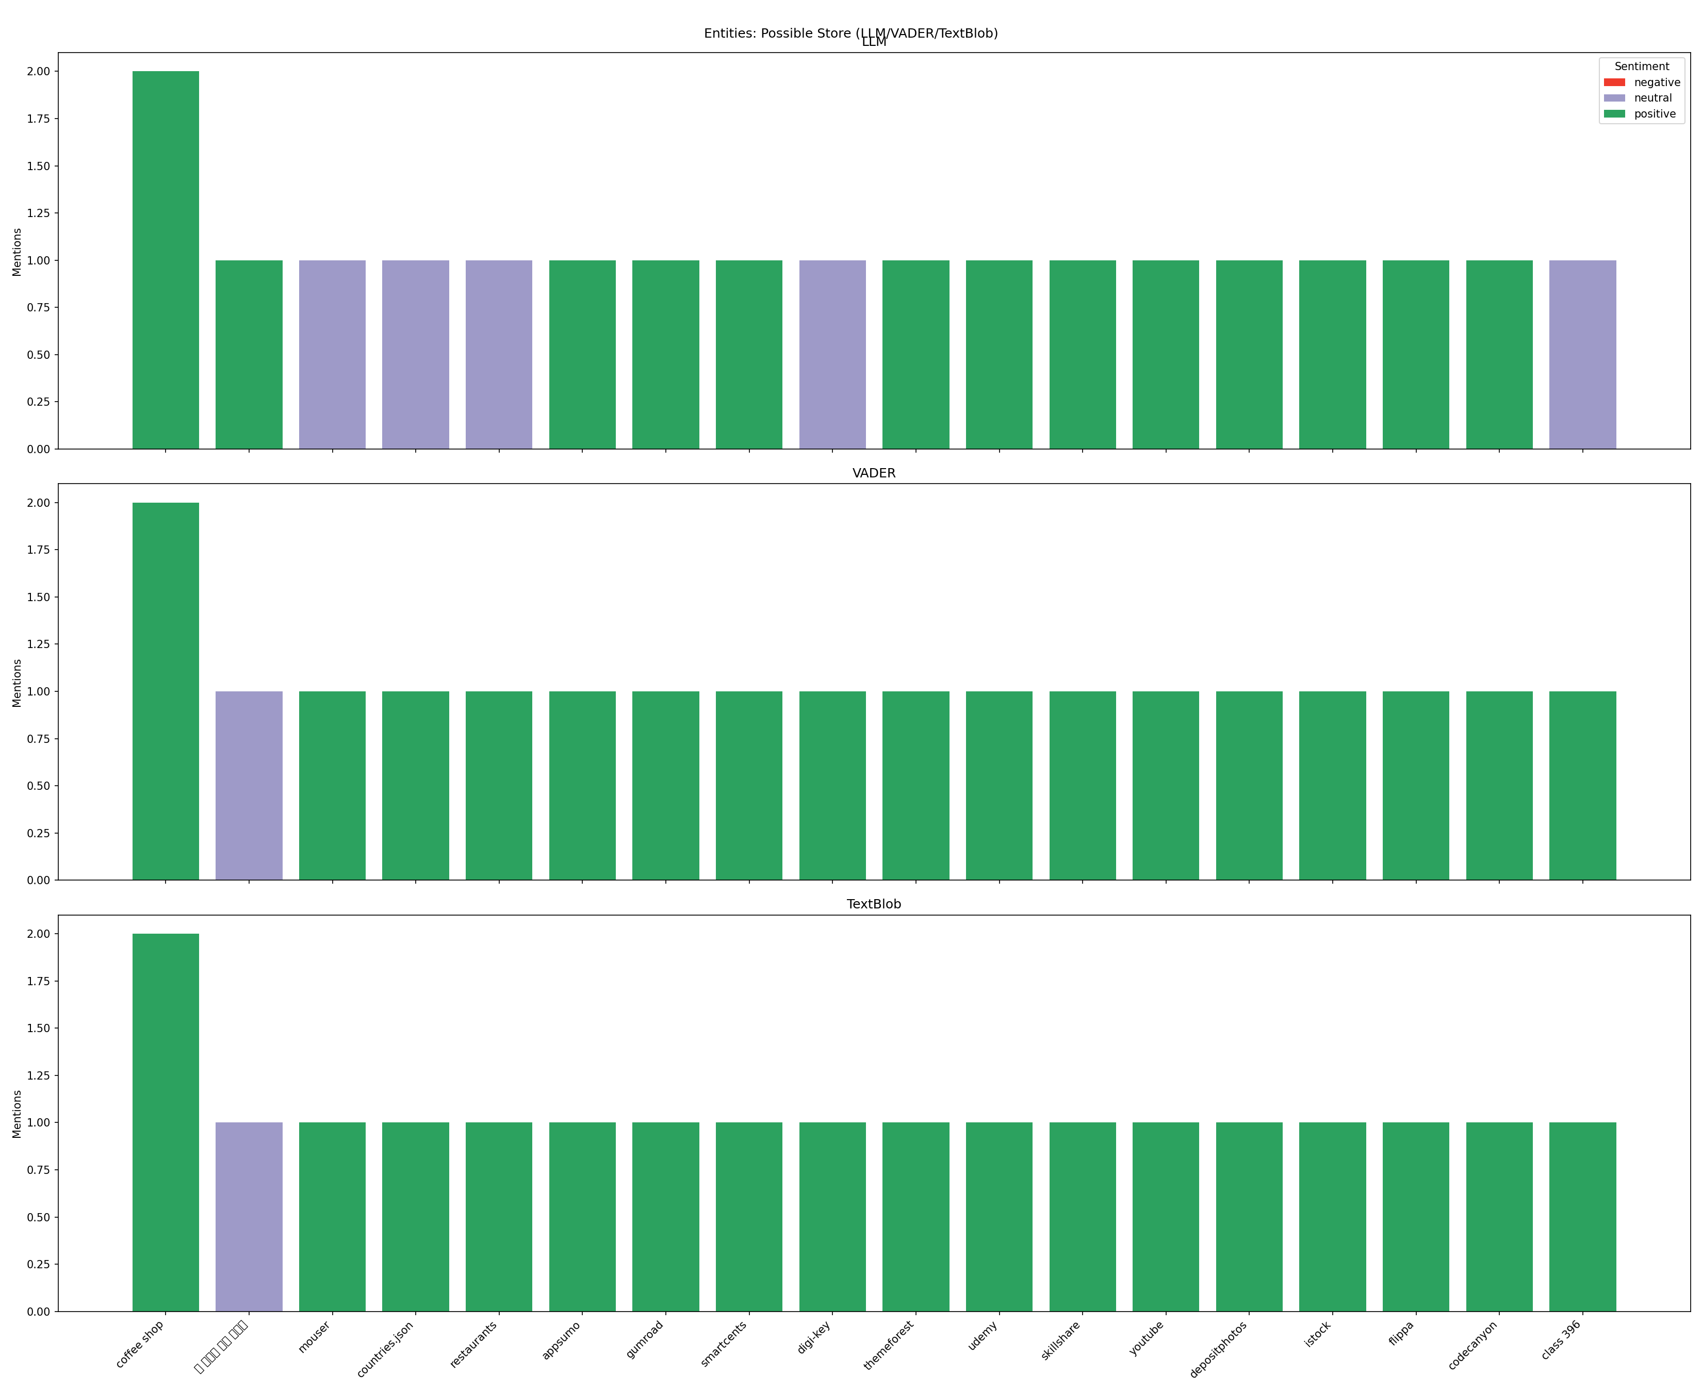
Multi-Sentiment Entity Analysis (Possible Stores)
Granular Entity-Level Insights
Multi-panel frequency charts for specific categories (Brand, Organization, Possible Brand/Store/Product) reveal sentiment patterns for individual entities:
Each entity's stacked bar shows sentiment distribution across three methods
Particularly valuable for tracking ambiguous mentions likely to be brands/stores/products
Essential for discovery of emerging entities not yet formally categorized
Strategic application: Compare sentiment profiles between direct competitors to identify competitive advantages and vulnerabilities in customer perception.

Slide 19
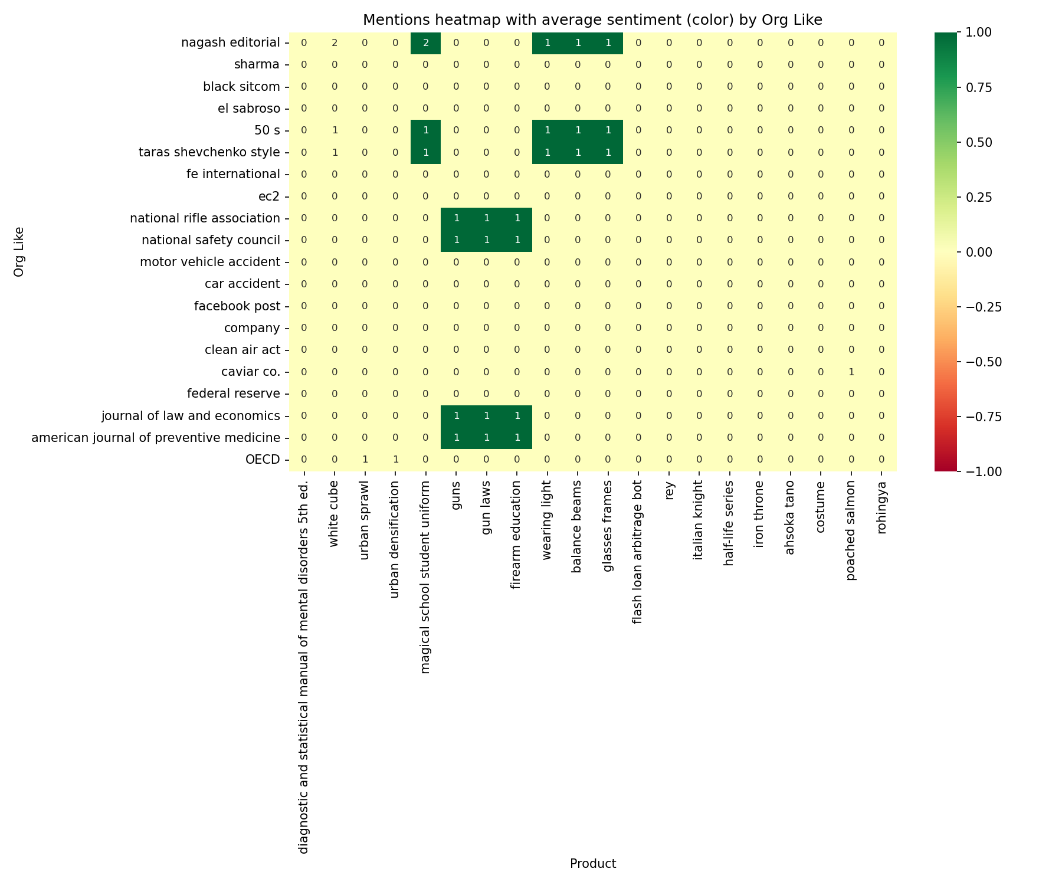
Entity Relationship Heatmaps (Organizations)
Store → Product Mentions
Brand → Product Mentions
Organization → Product Mentions
Rows represent top stores, columns show top products, with cells indicating mention counts and color reflecting average product sentiment (-1..1).
Reveals which products are most frequently associated with specific brands, highlighting strong and weak brand-product associations.
Maps relationships between organizations and products, useful for understanding institutional purchasing patterns and preferences.
These heatmaps provide critical insights for retail analytics, merchandising decisions, and competitive intelligence. High mention counts with positive sentiment indicate strong market associations worth leveraging in marketing and sales strategies.

Slide 20
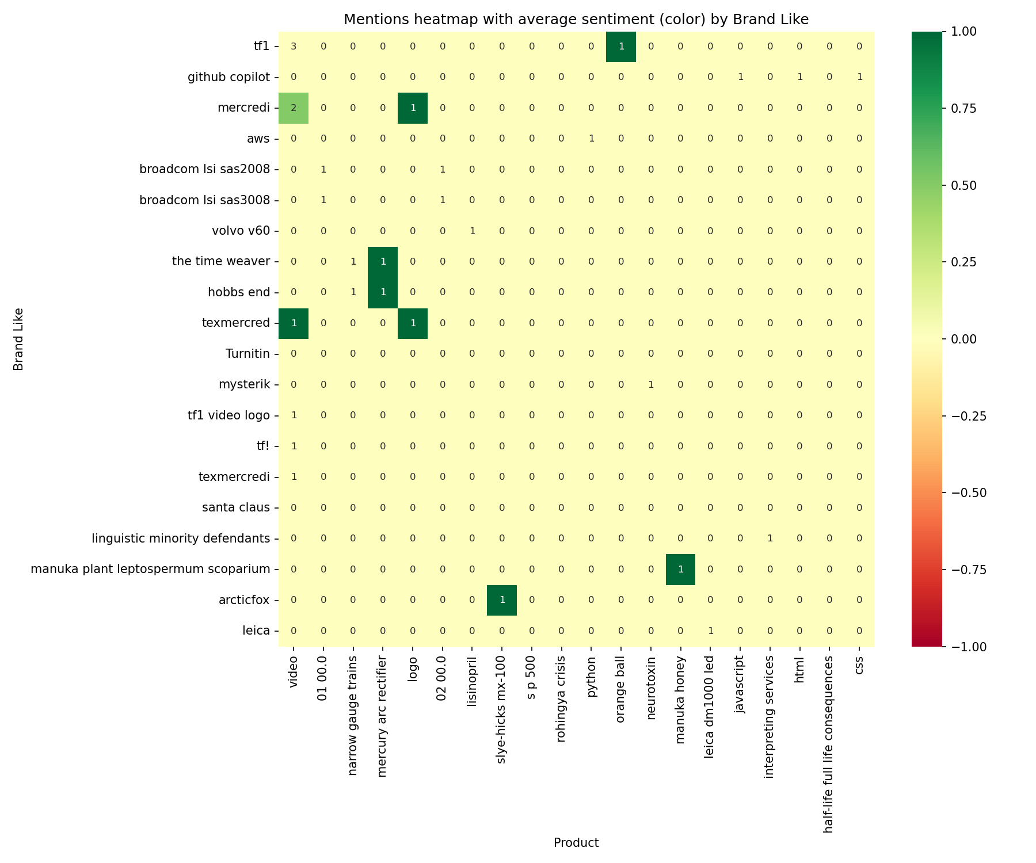
Entity Relationship Heatmaps (Brands)
Store → Product Mentions
Brand → Product Mentions
Organization → Product Mentions
Rows represent top stores, columns show top products, with cells indicating mention counts and color reflecting average product sentiment (-1..1).
Reveals which products are most frequently associated with specific brands, highlighting strong and weak brand-product associations.
Maps relationships between organizations and products, useful for understanding institutional purchasing patterns and preferences.
These heatmaps provide critical insights for retail analytics, merchandising decisions, and competitive intelligence. High mention counts with positive sentiment indicate strong market associations worth leveraging in marketing and sales strategies.

Slide 21
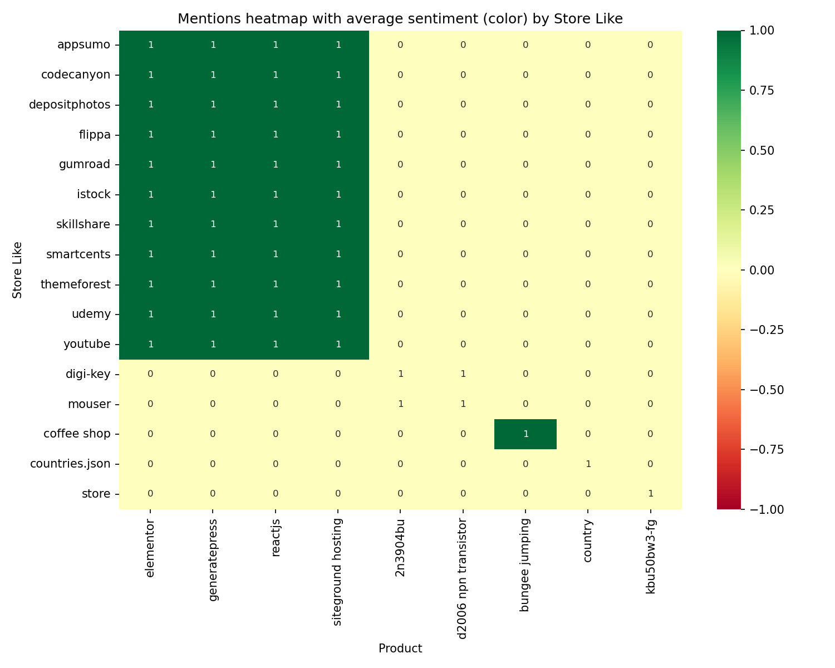
Entity Relationship Heatmaps (Stores)
Store → Product Mentions
Brand → Product Mentions
Organization → Product Mentions
Rows represent top stores, columns show top products, with cells indicating mention counts and color reflecting average product sentiment (-1..1).
Reveals which products are most frequently associated with specific brands, highlighting strong and weak brand-product associations.
Maps relationships between organizations and products, useful for understanding institutional purchasing patterns and preferences.
These heatmaps provide critical insights for retail analytics, merchandising decisions, and competitive intelligence. High mention counts with positive sentiment indicate strong market associations worth leveraging in marketing and sales strategies.

Slide 22
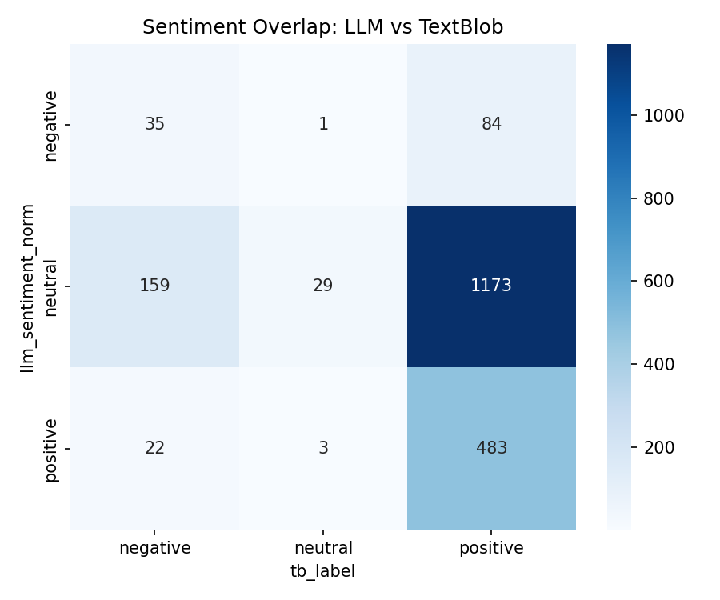
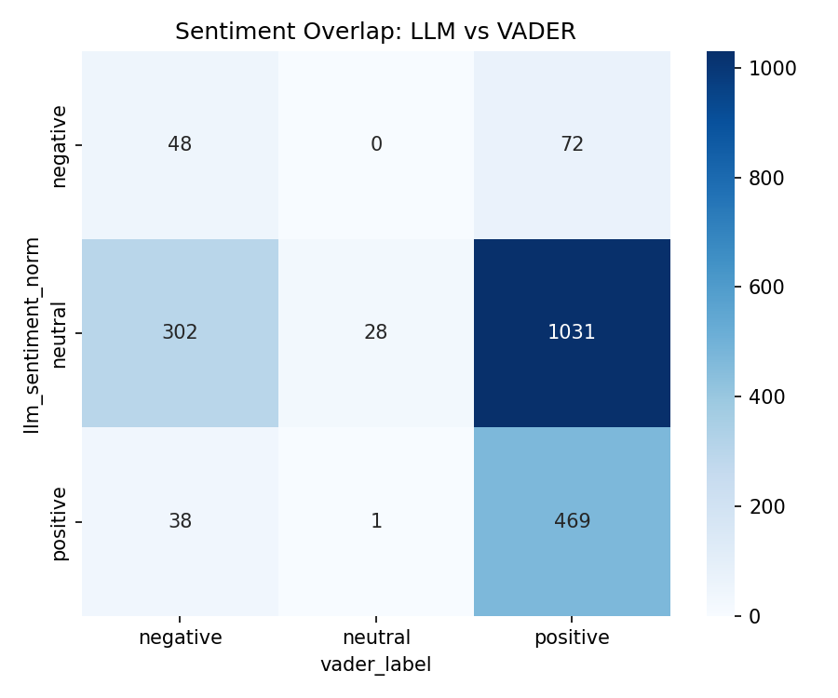
Sentiment Analysis Methodology Comparison
Agreement/Mismatch Matrices
These visualizations quantify how often different sentiment analysis methods agree or disagree on the same conversational data:
LLM vs. VADER comparison matrix
LLM vs. TextBlob comparison matrix
High agreement areas indicate confident sentiment assessment, while discrepancies highlight conversations requiring human review.
Methodology comparison helps calibrate confidence in sentiment analysis and identifies which types of conversations present challenges for automated sentiment detection.
When methods disagree significantly, consider examining raw conversation data to understand contextual nuances that automated systems might miss. These insights can inform ongoing refinement of sentiment analysis approaches.

